Slide 1

Campaign Results

Slide 2
Ads Created

Slide 3
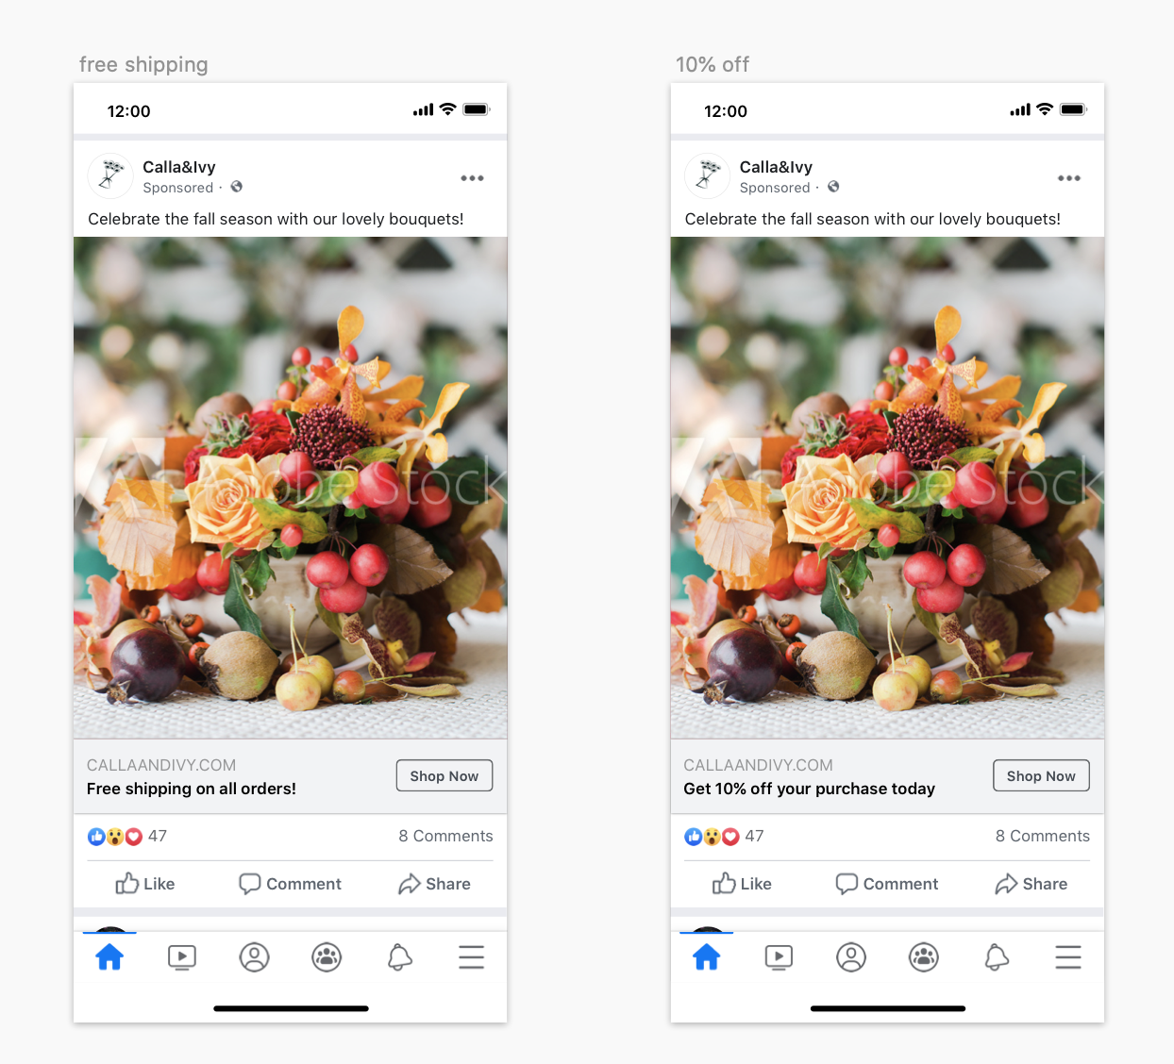

Slide 4
Ads Manager Reports

Slide 5
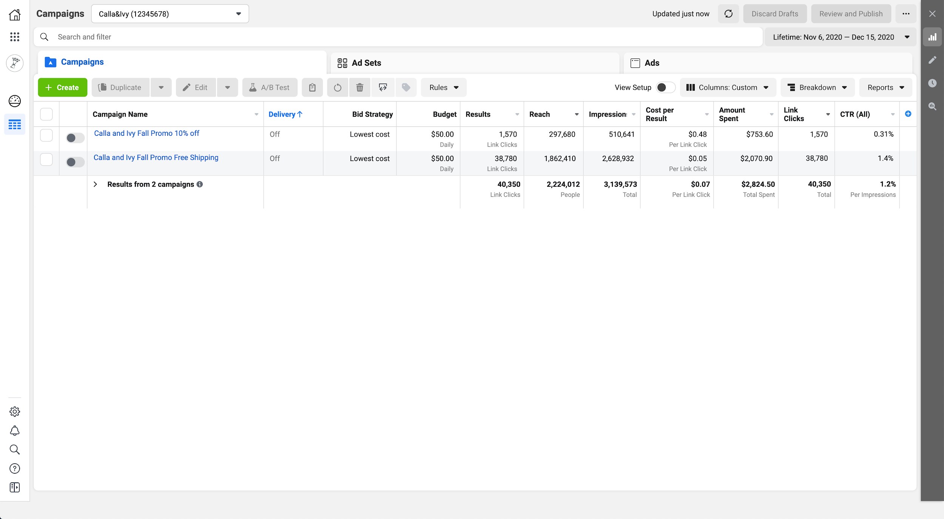

Slide 6
Internal Calla & Ivy Data

Slide 7
The campaign Calla & Ivy ran was focused on generating traffic to the website. Clicks on the ads result in website visits. While the focus of this campaign may not have been sales directly, as people visit the site, some people purchase flowers and that generates revenue that is directly associated with this campaign.
Calla & Ivy recorded the data below for the people that visit the site as a result of clicking on the ads in their campaign.
Definition | Data | Notes
Conversion Rate | 2% | 2% of the visits to the website result in a purchase
Average Purchase Value | $40 | On average, people spend $40 in every purchase on the Calla and Ivy website
Average cost per purchase | $15 | Calla and Ivy on average spends $15 per purchase (on flowers, employees etc.) - this excludes advertising costs.

Slide 8
A/B test results

Slide 9
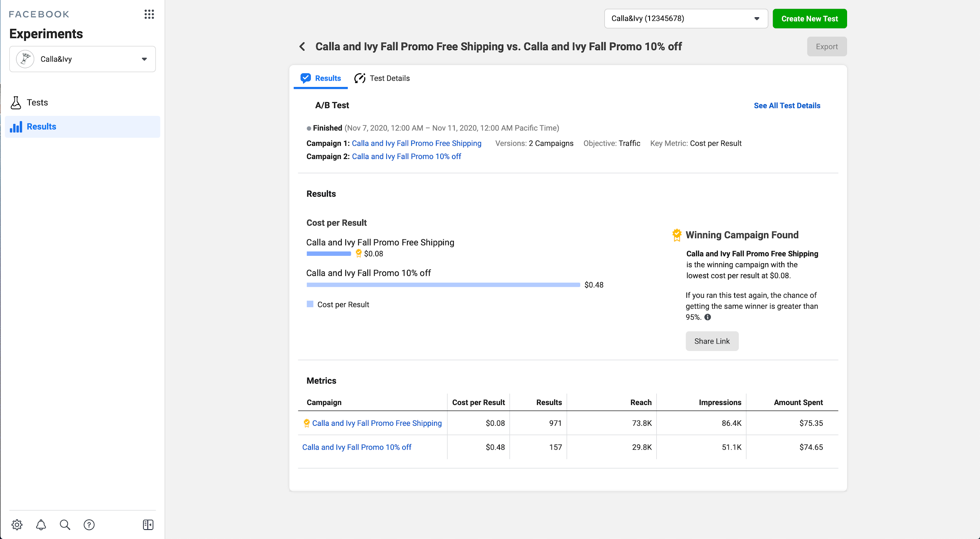

Slide 10
Formula Reminders

Slide 11
 | Formula | Notes
Number of Purchases | Number of website visits (clicks) * Conversion Rate | Conversion rate reflects how many visits result in a purchase.
ROAS | Revenue resulting from the ads/Cost of the ads | ROAS is the return on ad spend and only reflects costs from advertising
ROI | (Revenue - Total Investment)/Total Investment | Total Investment includes costs of goods + cost of advertising

Slide 12
Images and Logos

Slide 13



Logos

Slide 14


Images

Slide 15
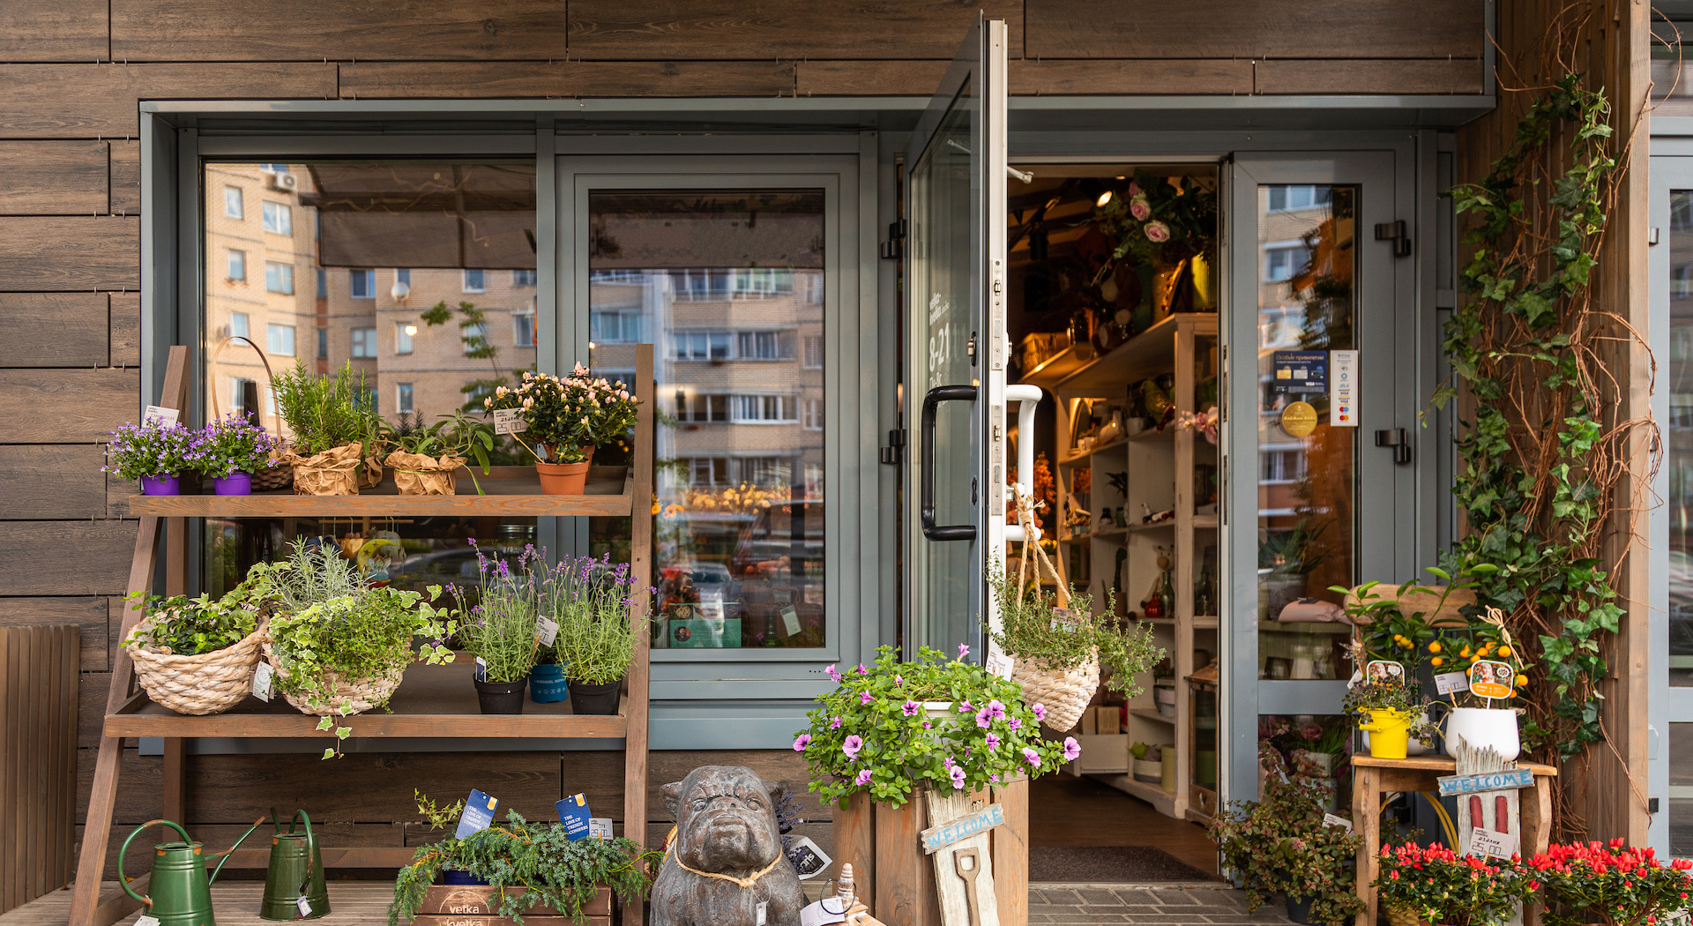

Slide 16


Slide 17


